Slide 1

Lecture Slides
Elementary Statistics
Twelfth Edition
and the Triola Statistics Series
by Mario F. Triola

Slide 2
Chapter 6
Normal Probability Distributions
6-1 Review and Preview
6-2 The Standard Normal Distribution
6-3 Applications of Normal Distributions
6-4 Sampling Distributions and Estimators
6-5 The Central Limit Theorem
6-6 Assessing Normality
6-7 Normal as Approximation to Binomial

Slide 3
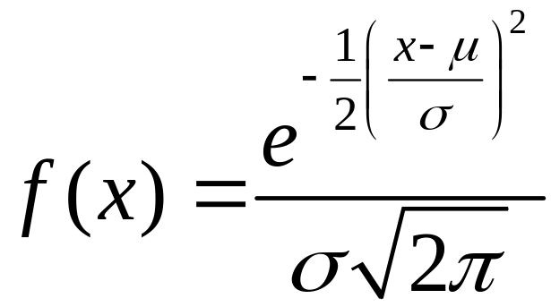
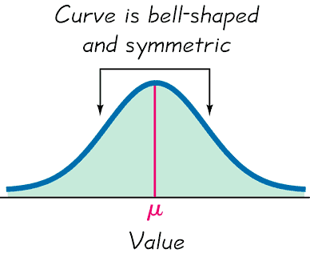
Preview
Preview
Chapter focus is on:
Continuous random variables
Normal distributions
Formula 6-1
Distribution determined by fixed values of mean and standard deviation
Figure 6-1

